Slide 1
Network Basics
KOHS Cyber Training Portal

Slide 2
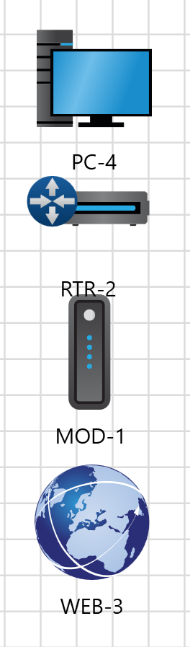
What is a Network?
A network is a community of linked devices for the purpose of sharing data
Common Parts of a Network:
Personal device- computer or tablet used for storing and processing data Switch- device that can connect together multiple devices
Router- software and hardware designed specifically for moving data between network devices
Modem- translator between devices and the internet
Internet- global network providing communication and information sharing capabilities

Slide 3

What is the Internet?
The internet is a global network providing communication and information sharing capabilities
Made up of billions of computers and electronic devices producing and sharing data
You access the world wide web which houses all websites through the internet
Devices send requests through servers to the internet, the internet in turn returns the correct data to the device
Network Map :
Internet
modem
router
User device

Slide 4
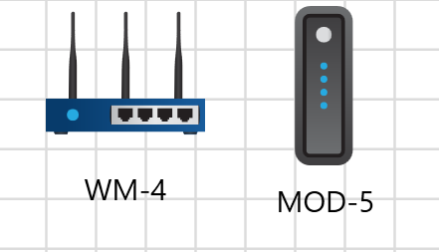
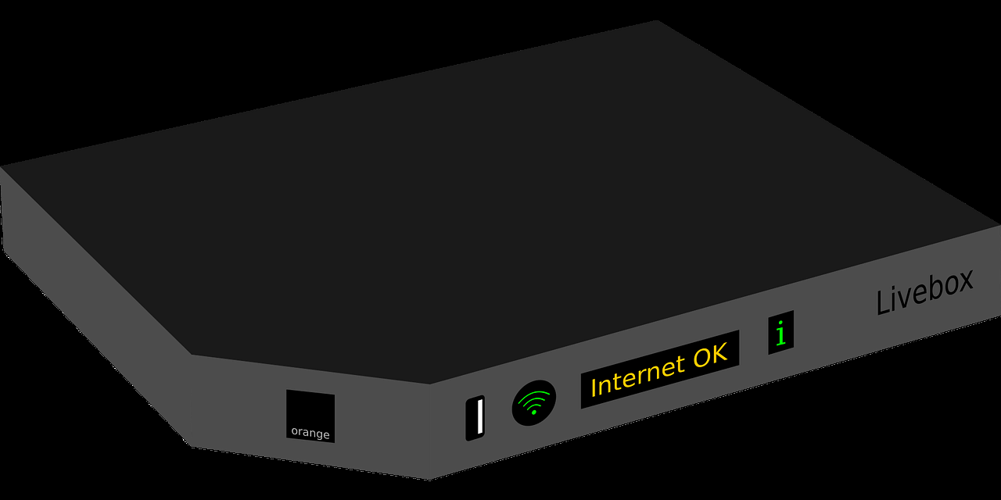
What is a modem?
Your modem allows your router to transmit data to the internet
Your modem translates binary code from your computer (01011010) into digital signals which can be processed by the internet
Binary code is transferred through a wired connection with the router, while digital signals are sent wirelessly
Your modem also translates digital signals from the internet into binary code to be processed by your router, then your personal device
Your modem and router can be housed in the same device
Network Map :
Internet
modem
router
User device

Slide 5
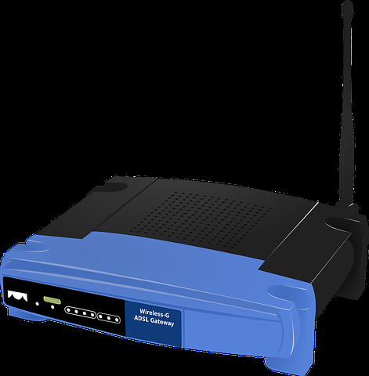
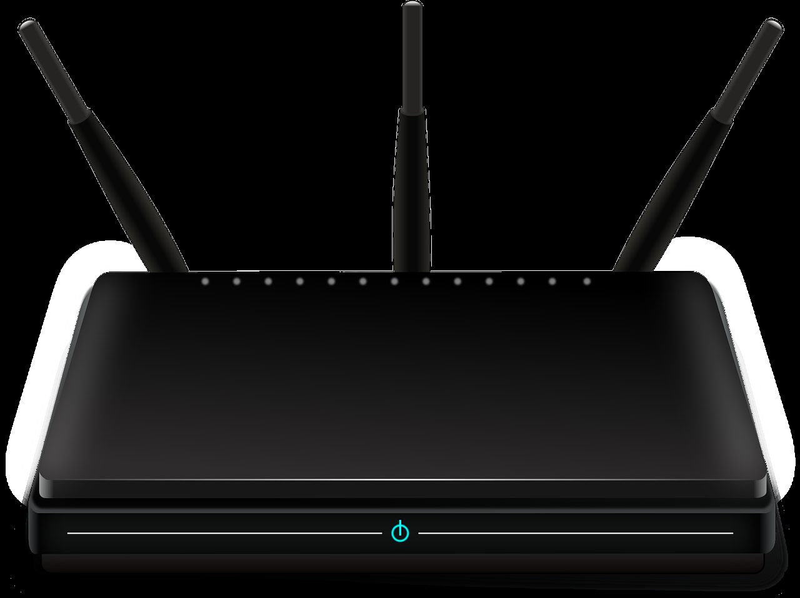
What is a Router?
A router acts the link between your computer and other networks
Without a router your computer would not connect to others or the internet
A router links your computer to other networks by taking the data transmitted by your computer and directing it to the right destination
Similarly, when other networks send your computer information it directs the data to the right place
Routers can be wired or wireless
Examples of routers:
Network Map :
Internet
modem
router
User device
Photos courtesy of Pixabay.com

Slide 6
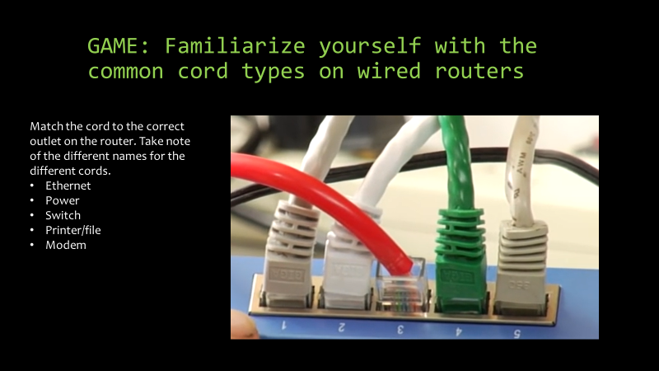

Slide 7
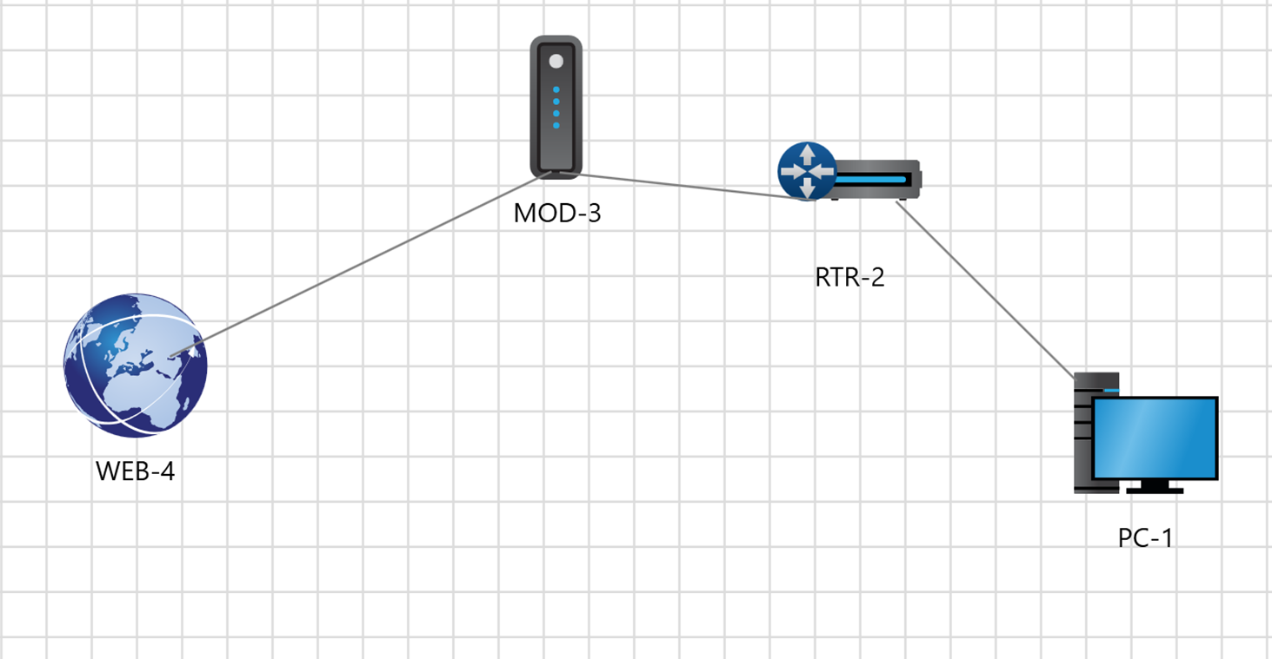
GAME: Build a Basic Network

